Slide 1
Floating Point Conversion

Slide 2
Floating point numbers
In binary
±1.xxxxxxx₂ × 2^{yyyy}
Three components of a floating point number
sign bit
exponent value (yyyy) and fraction (or mantissa or significand) value (1.xxxxxx)
Floating point standard: Defined by IEEE Standard 754-1985
Developed in response to divergent representations
Portability issues for scientific code
Now almost universally adopted
Two representations
Single precision (32-bit) In C and in DS5, these are declared as float
Double precision (64-bit) In C and in DS5, these are declared as double

Slide 3
Floating Point Numbers
Fixed point vs Floating point
Fixed number of fractional digits. 10.04 or 18.007
Note fixed points can be converted to integer: 10.04 can be treated as 1004 remembering that this is 100 times larger than original
If we fix the accuracy (fraction digits), we can use integer arithmetic
Floating point basically means that the decimal point can change its position
10.04 can be written as 100. 4 * 10⁻¹
or 0.1004 * 10²
or 1004.0*10⁻² or …..

Slide 4
Floating Point Numbers
To standardize (or normalize) we require all floating-point numbers look like
10.04 becomes 1.004 *10¹
0.00014 becomes 1. 4 *10⁻⁴
1234.567 becomes 1.234567 *10³
Let us consider binary representation of floating-point numbers

Slide 5
Binary Representation
What about binary?
It is the same but instead of base 10 we are dealing with base 2
±1.xxxxxxx₂ × 2^{yyyy}
Three components of a FP number
Sign bit ±
Exponent value 2^{yyyy}
Fraction 1.xxxxxxx₂
Defined by IEEE Standard 754-1985

Slide 6
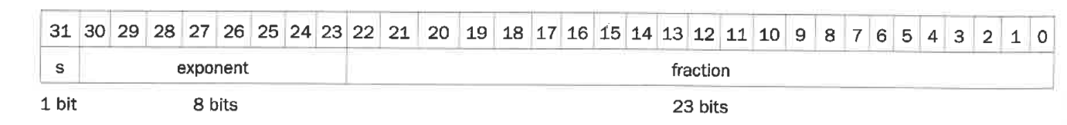
Single Precision (32-bit)
S: sign bit (0 ⇒ positive, 1 ⇒ negative)
Normalize significand: 1.0 ≤ | significand | < 2.0
Always has a leading pre-binary-point 1 bit,
so no need to represent it explicitly (hidden bit)
Significand is Fraction with the “1.”
Exponent: excess representation: actual exponent + Bias
Ensures exponent is unsigned
Single Precision (32 bits): (sign-bit),
8 bits of exponent, (Bias = 127)
23+1 bits of significand

Slide 7
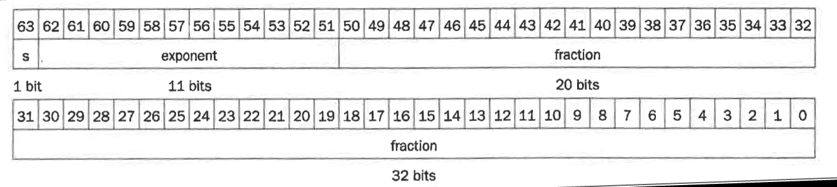
IEEE Standard for 64 bits
Double precision: 64 bit number
S: sign bit (0 ⇒ non-negative, 1 ⇒ negative)
11 bit exponent, bias = 1023
52+1 bit fraction (normalized)- +1 is for the implied 1 in significand (1.xxxx)

Slide 8
Converting Decimal Fractions To Binary
 | Converting (whole) integers to Binary
 |  | quotient | Remainder
106 | /2 | 53 | 0 | LSB
 | /2 | 26 | 1
 | /2 | 13 | 0
 | /2 | 6 | 1
 | /2 | 3 | 0
 | /2 | 1 | 1
 | /2 | 0 | 1 | MSB
 | 106 | = | 1101010
 | Converting fractions
0.1235 | *2 | 0.247 | 0 | MSB
 | *2 | 0.494 | 0
 | *2 | 0.988 | 0
 | *2 | 1.976 | 1
 | *2 | 1.952 | 1
 | *2 | 1.904 | 1
 | *2 | 1.808 | 1
 | *2 | 1.616 | 1
 | *2 | 1.232 | 1
 | *2 | 0.464 | 0
 | *2 | 0.928 | 0
 | *2 | 1.856 | 1
 | *2 | 1.712 | 1
 | 0.1235 | = | 0.0001111110011….

Slide 9
Example convert 0.75_{ten} to binary
Decimal 0.75 = .5 + .25
Binary 0.11 = .1 + .01
Normalized 1.1 * 2⁻¹
Since ALL FP binary numbers are a fraction between 1 and <2 they all begin with a 1.
So we drop leading one. There is no need to keep it. We will restore when we need the decimal representation
1.100000 becomes .10000000
Exponent = –1 + Bias
–1 + 127 = 126 = 01111110₂
0 01111110 1000…00 = 0x3F400000
Unlike integers, negative floating-point numbers (fraction part) is NOT in 2’s complement

Slide 10
FP Format
0.7*2 = 1.4 next fraction bit = 1
0.4*2 = 0.8 next fraction bit = 0
0.8*2 = 1.6 next fraction bit = 1
0.6*2 = 1.2 next fraction bit = 1
0.2*2 = 0.4 next fraction bit = 0
0.4*2 = 0.8 next fraction bit = 0
0.8*2 = 1.6 next fraction bit = 1
0.6*2 = 1.2 next fraction bit = 1
-----
0.7 = 0.01100110011….
Another example: represent 10.7 as a floating point
Converting 10 = 1010
Converting fraction 0.7 = 0.1011 0011 0011 0011 0011..
So, 10.7 = 0 1010.1011 0011 0011 0011 0011..
Or 1.01010110011001100110011….*2³ (Normalized)
Single Precision Biased exponent = 3+127 = 130 = 1000 0010
So, the number in single precision is
0100 0001 0010 1011 0011 0011 0011 0 011 = 0x 412B 3333_{hex}
Original # | Bit | Sub from #
0.7000000
0.2000000 | 1 | 0.500000
0.2000000 | 0 | 0.250000
0.0750000 | 1 | 0.125000
0.0125000 | 1 | 0.062500
0.0125000 | 0 | 0.031250
0.0125000 | 0 | 0.015625
0.0046875 | 1 | 0.007813
0.0007812 | 1 | 0.003906

Slide 11
Floating Point
Or 1.01010110011001100110011….*2³ (Normalized)
Single Precision Biased exponent = 3+127 = 130 = 1000 0010
So, the number in single precision is
0100 0001 0010 1011 0011 0011 0011 0 011 =0x 812B 3333_{hex}
A key point to remember: Hardware does not know if a 32 bit binary is
a). An instruction
b). A signed or unsigned integer
c). A floating point number
It is up to the programmer to use correct operations to let hardware interpret the 32-bit binary

Slide 12
Range OF SINGLE PRECISION FP
Exponents 00000000 and 11111111 reserved
Smallest value
Exponent: 00000001 ⇒ actual exponent = 1 – 127 = –126
Fraction: 000…00 ⇒ significand = 1.0
±1.0 × 2^{–126} ≈ ±1.2 × 10^{–38}
Largest value
exponent: 11111110 ⇒ actual exponent = 254 – 127 = +127
Fraction: 111…11 ⇒ significand ≈ 2.0
±2.0 × 2⁺¹²⁷ ≈ ±3.4 × 10⁺³⁸

Slide 13
Rounding
Some additional IEEE 754 Standard specifications
Rounding: four modes
round to next even number (default)
round towards zero (nearest smaller number if positive)
round towards + ∝
round towards - ∝
Special codes to represent (single precision)
NaN (exponent = 255 or 11111111 ; fraction = nonzero)
+∝ , - ∝ (exponent = 255; fraction = 0)
denormlized number (too small to represent)
(exponent = 0 or 00000000; fraction = nonzero)

Slide 14
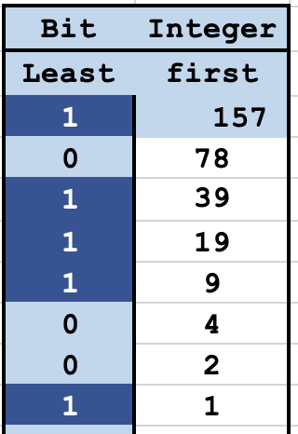
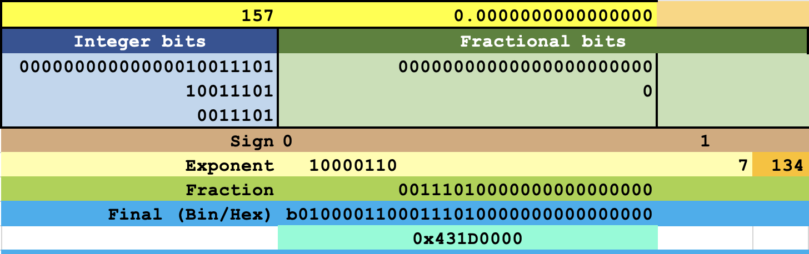
A Floating-Point number without a floating Point
Let’s start with the number
157.0

Slide 15
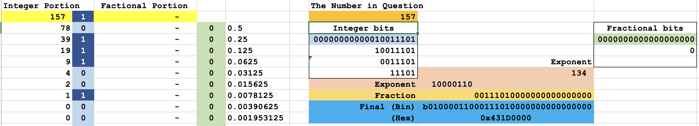
Is there an Integer portion?
What is the binary representation of
157
Divide by 2 and save the remainder
The bits are generated from least to most significant bits
1 + 2 + 4 + 8 + 16 + 32 + 64 + 128
The binary value of the integer portion
1 0 1 1 1 0 0 1
Now showing them in most to least
10011101

Slide 16
no Fractional portion
Determine the Exponent
Shift off the MSB (far left 1 bit)
00000000000010011101
Becomes
00000000000010011101
0011101

Slide 17
Determine the Exponent
The count the remaining bits 0011101
Add that to 127 134 = 127 + 7
This is the exponent 2⁷

Slide 18
Determine the Fraction
Take care of the sign bit: The leading bit is:
0 If Positive 1 If Negative
The next 8 bits are the Exponent
The final 23 bits are the Fraction (pad with zeros)

Slide 19
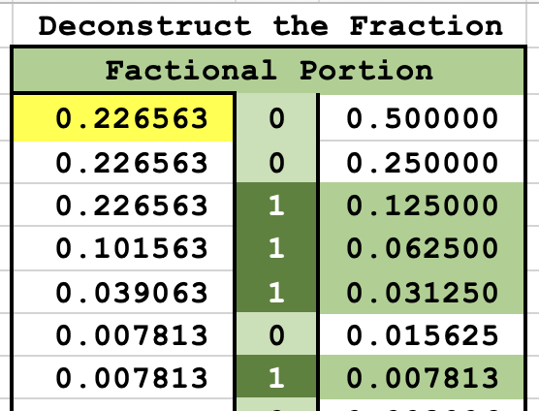
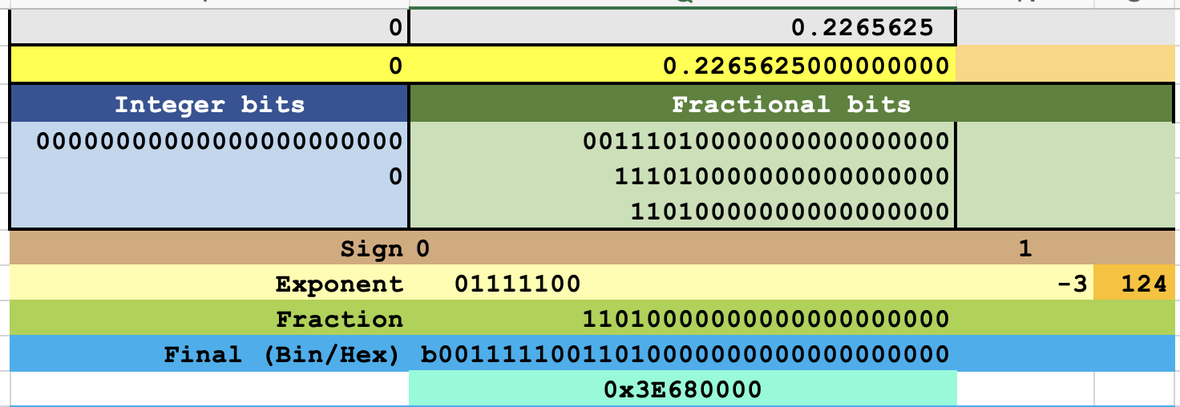
Faction only
Let’s begin with 0.2265625
Faction is
0.5 + 0.125 + 0.125 + 0.0625 + 0.03125 + 0.015625 + 0.078125
0 0 1 1 1 0 1

Slide 20
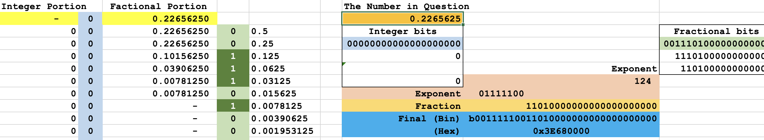
Keep subtracting
What are the binary parts of: 0.2265625
Determine the binary value of the factional portion
0.5 + 0.25 + 0.125 + 0.0625 + 0.03125 + 0.015625 + 0.078125
0.0 0 1 1 1 0 1 000000000…

Slide 21
Calculate the Exponent
Remove the leading 0s and the FIRST leading 1
Two Leading zeros + the first 1 = 3
0011101000000000000
Or think about moving the decimal to the right 3 Xs
The 3 shifts would be the same as multiplying by 2⁻³

Slide 22
Calculate the Exponent
Add that shift count to 127 + -3 = 124
convert to binary
01111100

Slide 23
Determine the Fraction
Remove the leading 0s and the FIRST leading 1
What is left is the Fractional portion
0011101000000000000

Slide 24
And the Answer is!
Take care of the sign bit: The leading bit is:
0 If Positive 1 If Negative 0
The next 8 bits are the Exponent 01111100
The final 23 bits are the Fraction 1101000000000000
0011 1110 0110 1000 0000 0000 0…
Final Hex 3E68 0000

Slide 25
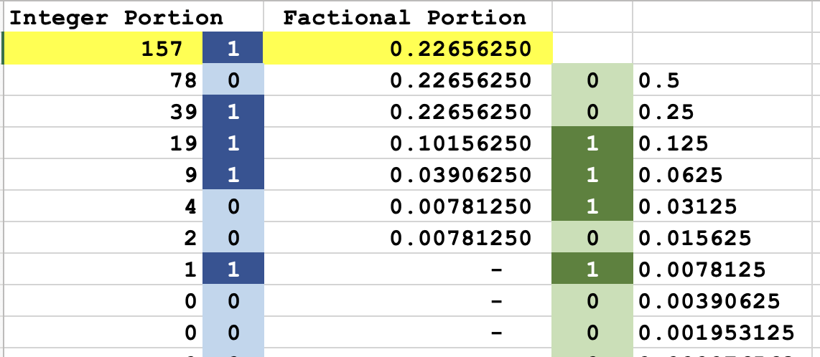
Integer and Factional Numbers
Lets do both this time
Convert Integer to binary 10011101
Convert the faction to binary 0011101

Slide 26
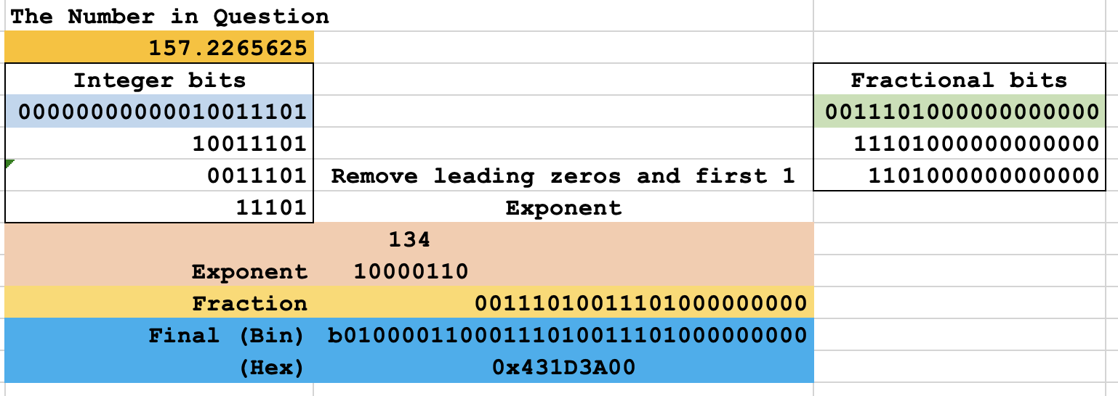
Follow steps for the Integer Example
Determine the Exponent
Shift off the MSB (far left 1 bit) of the integer
Count the remaining Integer bits
Add that to 127 134 = 127 + 7
10000110

Slide 27
Sign + Exponent + Fraction
Take care of the sign bit: The leading bit is:
0 If Positive 1 If Negative
The next 8 bits are the Exponent
The final 23 bits are the Fraction (pad with zeros)
Integer followed by the fraction

Slide 28
Dividing by 10
Decimal Number | Floating Point | Power
377377.000000000000000 | 0 10010001 01110000100010000100000 | 18
37737.700000000000000 | 0 10001110 00100110110100110110011 | 15
3773.770000000000000 | 0 10001010 11010111101110001010001 | 11
377.377000000000000 | 0 10000111 01111001011000001000001 | 8
37.737700000000000 | 0 10000100 00101101111001101100111 | 5
3.773770000000000 | 0 10000000 11100011000010101110010 | 1
0.377377000000000 | 0 01111101 10000010011011110001100 | -2
-0.037737700000000 | 1 01111010 00110101001001011000000 | -5
10 is equal to 2^{3.322}
For every multiple of 10 there are 3.3 powers of 2
You can see this in the power column changing by 3, 3 and 4

Slide 29
Dividing by 2
Here these numbers drop by a power 2 each time
Note that the fractional bits stay the same
Decimal Number | Floating Point | Power
127.3281250 | 0 10000101 11111101010100000000000 | 6
63.6640625 | 0 10000100 11111101010100000000000 | 5
31.8320313 | 0 10000011 11111101010100000000000 | 4
15.9160156 | 0 10000010 11111101010100000000000 | 3
7.9580078 | 0 10000001 11111101010100000000000 | 2
3.9790039 | 0 10000000 11111101010100000000000 | 1
1.9895020 | 0 01111111 11111101010100000000000 | 0
0.9947510 | 0 01111110 11111101010100000000000 | -1
0.4973755 | 0 01111101 11111101010100000000000 | -2
0.2486877 | 0 01111100 11111101010100000000000 | -3

Slide 30
FP Instructions
Convert Integer register value to a FP register
SCVTF S6, X11 // convert X11 to S6 FP
Set a FP register to 0
FSUB S1, S6, S6 // initialize S1 = 0.0
Basic Multiplication and Addition and Division
FMUL S7, S7, S7 // S7 = S7 squared
FADD S6, S6, S7 // sum = sum + S7
FDIV S6, S6, S5 // S6 = sum/n
How about something fancy Square Root
FSQRT S2, S6 // S2 = SQRT(sum / n)

Slide 31
FP Instructions in LEGv8 and ARMv8
Separate FP registers Just like 32 integer registers X0,X1,…, X31
32 single-precision: Registers are labeled S0, …, S31
Double-precision: Registers are labeled D0, …, D31 store upper 32 bits
Lower 32 bits of double precision in corresponding S registers
FP instructions operate only on FP registers
(Integer instruction only operate on X registers)
FP load and store instructions
We need to use these to get floating point data into floating point registers
LDURS, LDURD //for LEGv8
STURS, STURD //for LEGv8
ARMv8, uses LDUR and STUR even for loading floating point
For example: LDUR S3, [X0, #4] or LDUR D2, [X0, #8]
STUR S3, [X0, #0] or STUR D1, [X1, #16]
→ memory addresses are unsigned inters and hence we use X registers

Slide 32
FP Instructions in LEGv8 and ARMv8
Single-precision arithmetic
FADDS, FSUBS, FMULS, FDIVS in LEGv8
e.g. FADDS S1, S2, S3
In ARMv8, there is no “S” with the instruction
FADD S2, S4, S6 → in ARMv8
Double-precision arithmetic
FADDD, FSUBD, FMULD, FDIVD in LEGv8
e.g. FADDD D2, D4, D6
In ARMv8, there is no “D” with the instruction
FADD D2, D4, D6 → in ARMv8
Single- and double-precision comparison
FCMPS, FCMPD (compare two floating point values in floating point registers) in LEGv8
Sets or clears FP condition-code bits
In ARMv8, use FCMP for both single and double precision
Branch on FP condition code true or false
B.Cond (like B.GT)

Slide 33
FP Example: °F to °C
C code:
float f2c (float fahr) { return ( ( 5.0 / 9.0 ) * ( fahr - 32.0 ) );
}
We will store constants 5.0, 9.0 and 32.0 in an array with 3 elements
We will store the address of this array in X27
The argument fahr will be supplied in S12, and the result in S0
Note single precision numbers are 32 bits or 4 bytes long
Compiled LEGv8 (ARMv8 only red part) code:
f2c:
LDURS S16, [X27, #0] // S16 = 5.0 (5.0 in data memory) X27 is the address of 5.0
LDURS S18, [X27, #4] // S18 = 9.0 (9.0 in data memory) 9.0 stored next to 5.0
FDIVS S16, S16, S18 // S16 = 5.0 / 9.0
LDURS S18, [X27, #8] // S18 = 32.0 32.0 stored next to 9.0
FSUBS S18, S12, S18 // S18 = fahr – 32.0
FMULS S0, S16, S18 // S0 = (5/9)*(fahr – 32.0)
BR LR // return (result in S0)

Slide 34
Fahrenheit to Celsius
Main and the rest of the code needed to run on DS5
.data
.type temp. %object
.type const, %object
.size temp, 1
.size const, 3
temp: .float 98.7
const: .float 5.0, 9.0, 32.0
.text
.global main
.global f2c
.arch armv8-a+fp+simd
.type main, %function
.type f2c, %function
f2c:
LDUR S16, [X27, #0] // 5.0
LDUR S18, [X27, #4] // 9.0
FDIV S16, S16, S18 // 5.0 / 9.0
LDUR S18, [X27, #8] // 32
FSUB S18, S12, S18 // temp – 32.0
FMUL S0, S16, S18 // * (5 / 9)
BR LR
main:
ADRP X27, const
ADD X27, X27, :lo12:const
ADRP X28, temp
ADD X28, X28, :lo12:temp
LDUR S12, [X28, #0]
BL f2c // result is in S0
Exit:

Slide 35
FP Example: °F to °C
If you need double precision: use D registers
Declare data types using .double
If you are running programs using floating point, remember that you need to look at S or D registers. They are part of SIMD registers (not core)
You can still view the contents of memory (by dropping the address in memory window)

